Slide 1
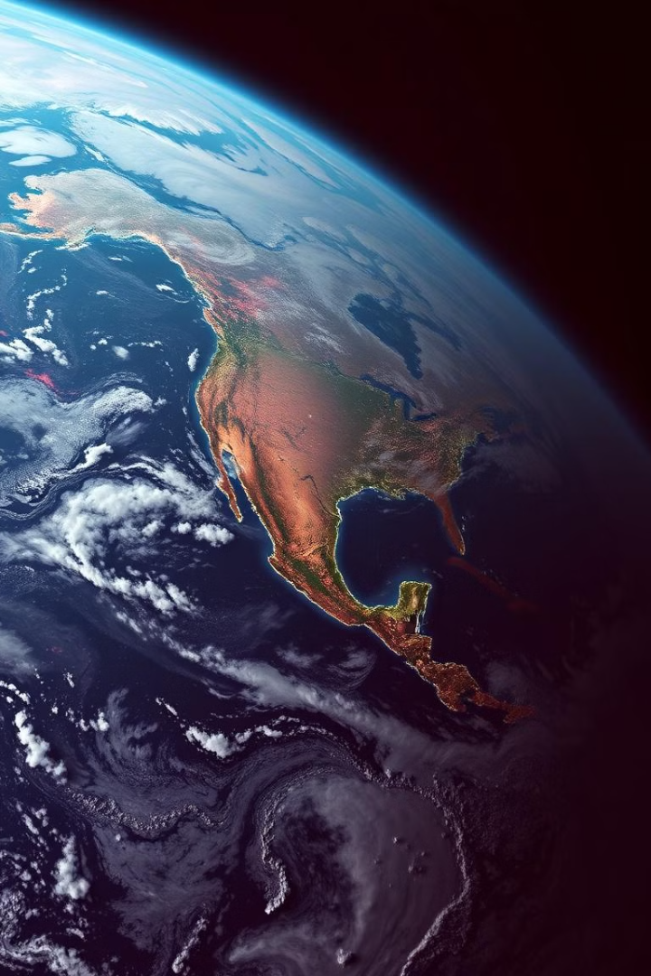
Satellite-based solutions for global warming prevention
Climate change is a global threat, but satellite technology offers innovative solutions. Satellites can monitor greenhouse gas emissions, track renewable energy sources, and predict natural disasters.
by Baalamuruga Sivam BS

Slide 2

The greenhouse effect and its impact on the planet
1
Greenhouse Gases
2
Climate Change
3
Global Impacts
Certain gases, like carbon dioxide, methane, and nitrous oxide, trap heat in the atmosphere, causing the planet to warm.
Increased greenhouse gas concentrations lead to global warming, impacting weather patterns, sea levels, and ecosystems.
These changes result in more frequent and severe heat waves, droughts, floods, and storms, affecting human populations and biodiversity.

Slide 3
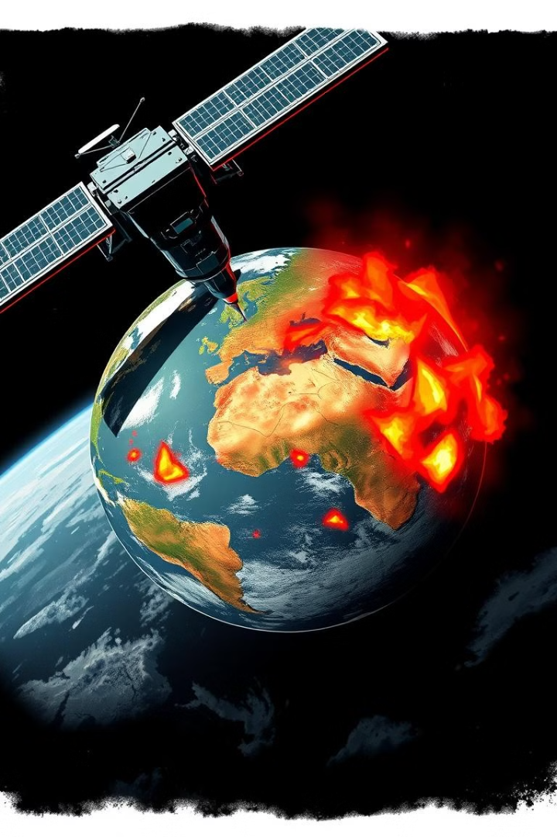
Monitoring and measuring greenhouse gas emissions from space
Satellite
Greenhouse Gas Measured
Applications
GOSAT
Carbon dioxide
Global monitoring of CO2 emissions from power plants and industries
OCO-2
Carbon dioxide
Precise mapping of CO2 sources and sinks in terrestrial ecosystems
Sentinel-5P
Methane, nitrogen dioxide, ozone
Monitoring air pollution and methane leaks from oil and gas infrastructure

Slide 4
Satellite data for carbon sequestration and reforestation
Carbon Sequestration
Reforestation
Sustainable Management
Forests absorb carbon dioxide from the atmosphere, mitigating global warming. Satellites can assess forest health and carbon storage potential.
Satellite data helps identify suitable areas for reforestation projects, promoting biodiversity and combating climate change.
Monitoring deforestation, forest degradation, and carbon stock changes enables sustainable forest management and conservation.

Slide 5
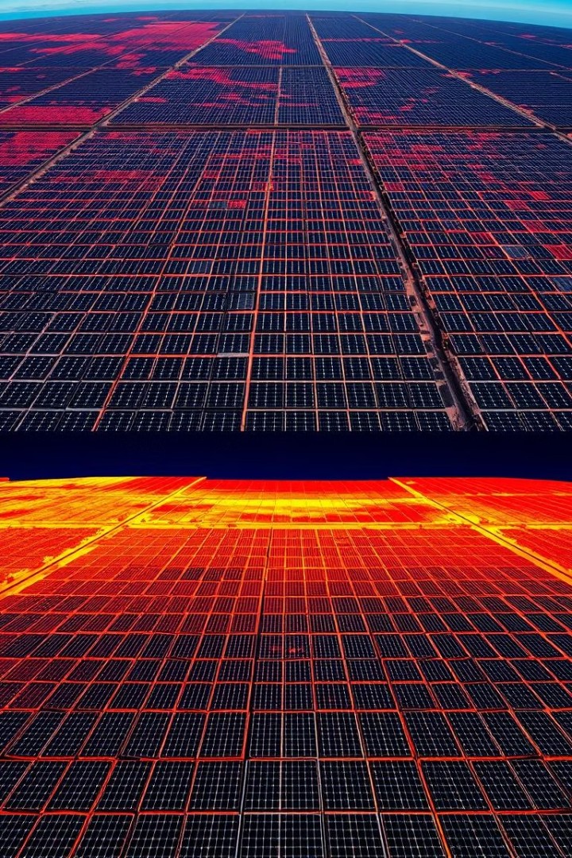



Renewable energy tracking and optimization from orbit
Solar Power
Satellites monitor solar irradiance and cloud cover to optimize solar panel placement and energy production.
Wind Power
Satellite data helps identify areas with optimal wind speeds, maximizing wind turbine efficiency and energy generation.
Hydropower
Satellites monitor water levels in reservoirs and rivers to optimize hydroelectric power generation and manage water resources.

Slide 6
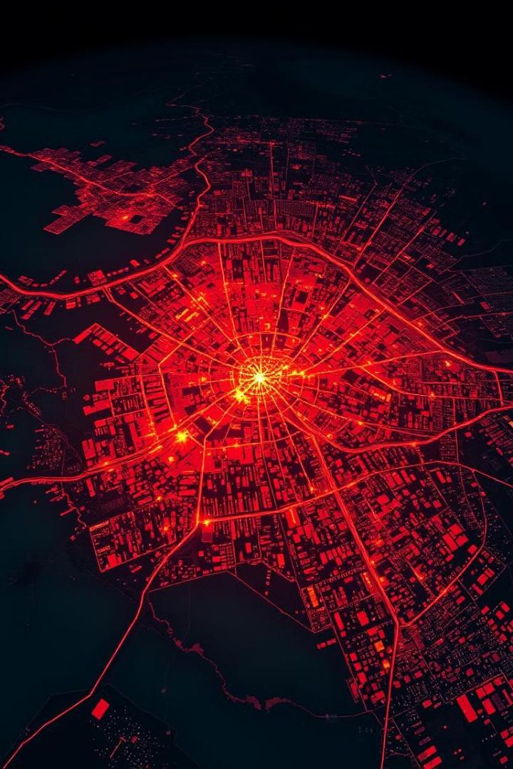
Mitigating the urban heat island effect with satellite imagery
1
Urban Heat Islands
Cities retain heat more than surrounding areas due to concrete and asphalt, creating urban heat islands.
2
Satellite Monitoring
Satellites measure surface temperatures to identify urban heat islands and assess their impact on human health and energy consumption.
3
Mitigation Strategies
Using satellite data, city planners can implement green roofs, urban forests, and reflective surfaces to reduce heat islands.

Slide 7
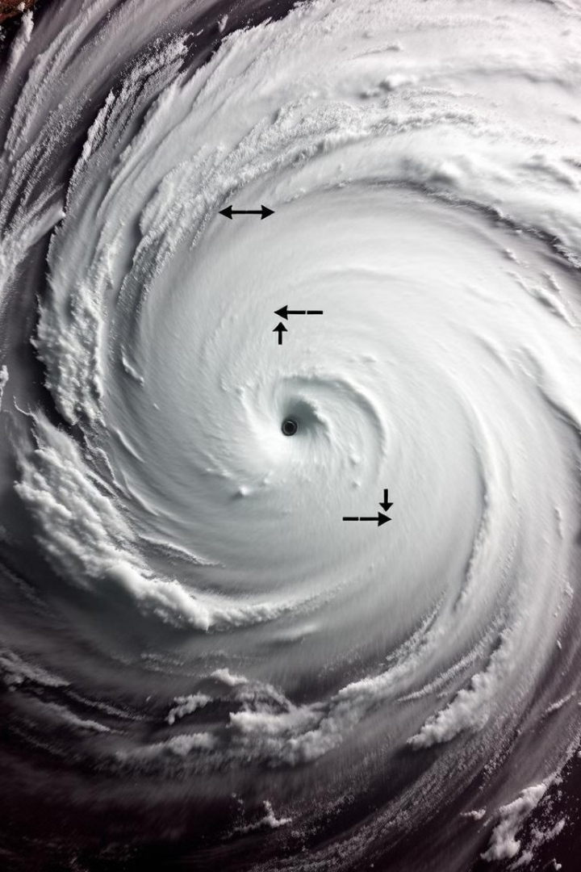



Predicting and managing climate-related natural disasters
Disaster Prediction
Satellites monitor weather patterns, ocean currents, and sea levels to predict and track hurricanes, floods, and droughts.
Early Warning Systems
Satellite data enables early warning systems, allowing for timely evacuations and disaster preparedness measures.
Damage Assessment
Satellites provide post-disaster assessments of damage to infrastructure, crops, and ecosystems, aiding in recovery efforts.

Slide 8

Conclusion: The role of satellite technology in addressing climate change
Satellite technology plays a crucial role in understanding and mitigating climate change. By monitoring greenhouse gas emissions, tracking renewable energy, and predicting natural disasters, satellites provide valuable insights and tools for building a sustainable future.

